Slide 1
Reduzindo discriminação em classificadores
Hilton Pintor (hpbl)
Victor Miranda (vmm)
github.com/if1015-datascience-ufpe/2018-2-ex3-p2p

Slide 2
Tópicos
Decisores
O que são?
Naive Bayes
Árvores de decisão
Problemática
Discriminação em bases de dados
O que é discriminação
Como afeta decisores
Impacto em casos reais
Soluções
Dependency-aware tree construction
Leaf Relabeling
Resultados
Modifiying naive bays
Two naive Bayes models
Latent variable model
Resultados

Slide 3
O que são decisores?

Slide 4
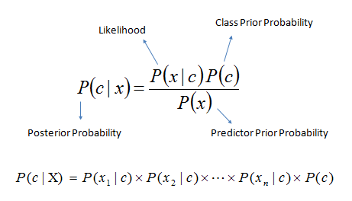
Naive bayes

Slide 5
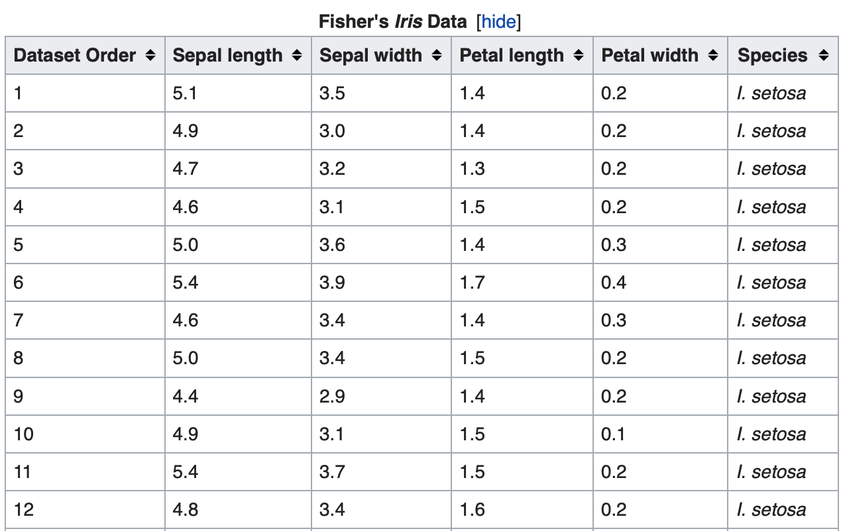
Árvores de Decisão
Dados de treinamento
Dados de teste
Iris data
Classificar espécie da flor
[setosa, versicolor, virginica]

Slide 6
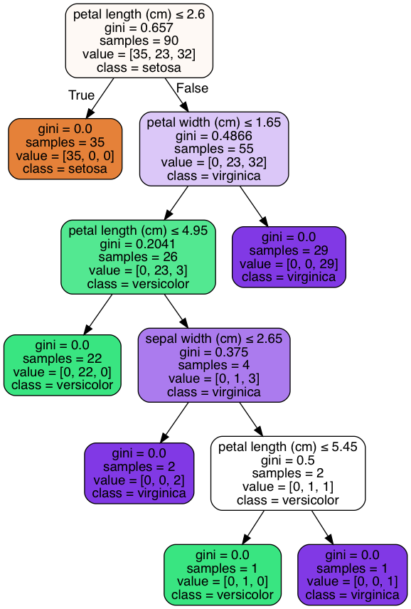
Árvores de Decisão
Questionamento sobre os atributos nos nós
Particiona os dados
Classifica nas folhas
[setosa, versicolor, virginica]

Slide 7
Discriminação em decisores

Slide 8
O que é discriminação?
"Discrimination is a sociological term that refers to the unfair and unequal treatment of individuals of a certain group based solely on their affiliation to that particular group, category or class.
Such discriminatory attitude deprives the members of one group from the benefits and opportunities which are accessible to other groups"

Slide 9
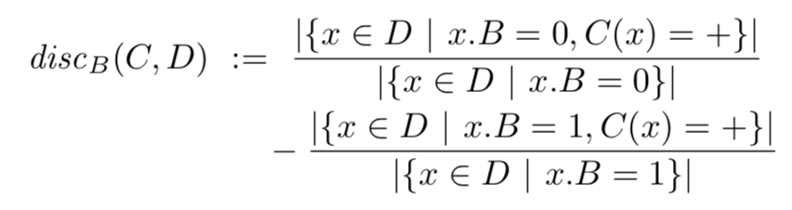
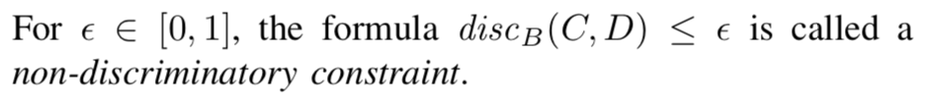
Discriminação nos decisores
Notes:
Let 𝐵 be a binary attribute with domain dom(𝐵) = {0,1}. The discrimination of 𝐶 w.r.t. 𝐵 in dataset 𝐷, denoted disc𝐵(𝐶,𝐷) is defined as :

Slide 10
Exemplos práticos
Seguros
Liberdade Condicional
Bancos

Slide 11
Soluções propostas

Slide 12
Modelos tradicionais
Remover atributos sensíveis
Massaging
Reweighing
Red-lining
Notes:
As shown in previous works [7], [3], simply removing the sensitive attribute from the training data does not work, as other attributes may be correlated with the suppressed attribute. It was observed that classifiers tend to pick up these relations and discriminate indirectly.

Slide 13
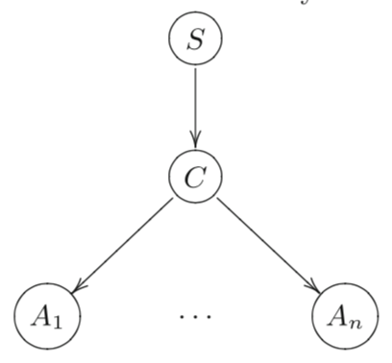

Modifiying naive Bayes

Slide 14
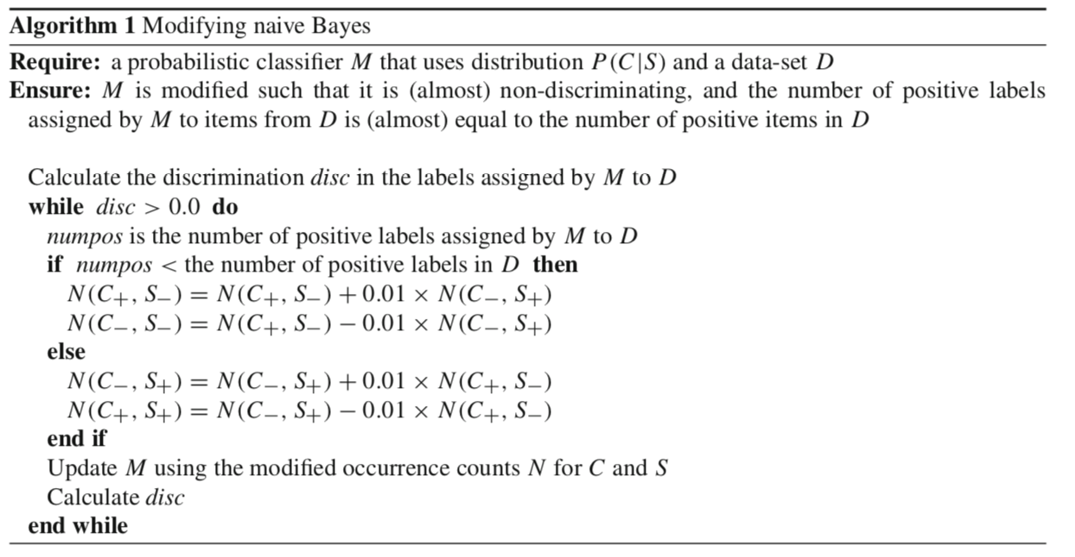
Modifiying naive Bayes

Slide 15
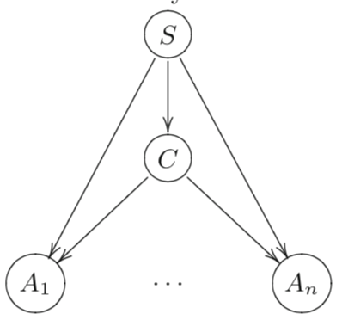
2 naive bayes models

Slide 16
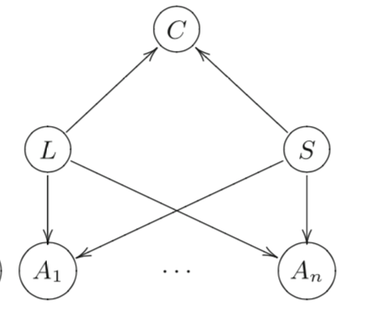
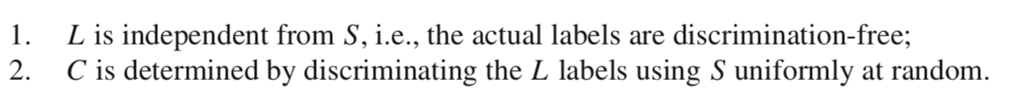
Latent variable model

Slide 17
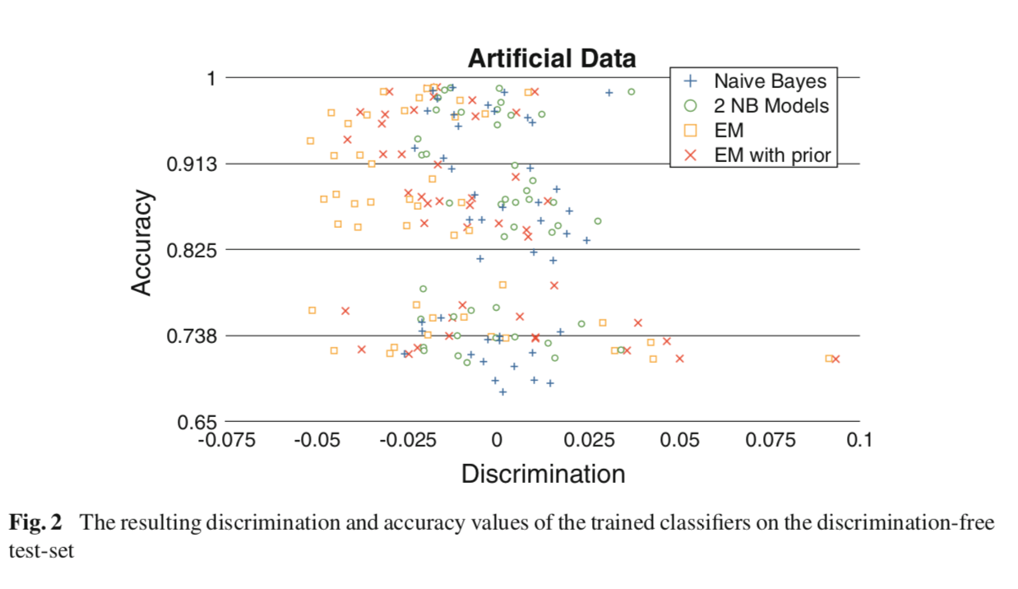
Resultados

Slide 18
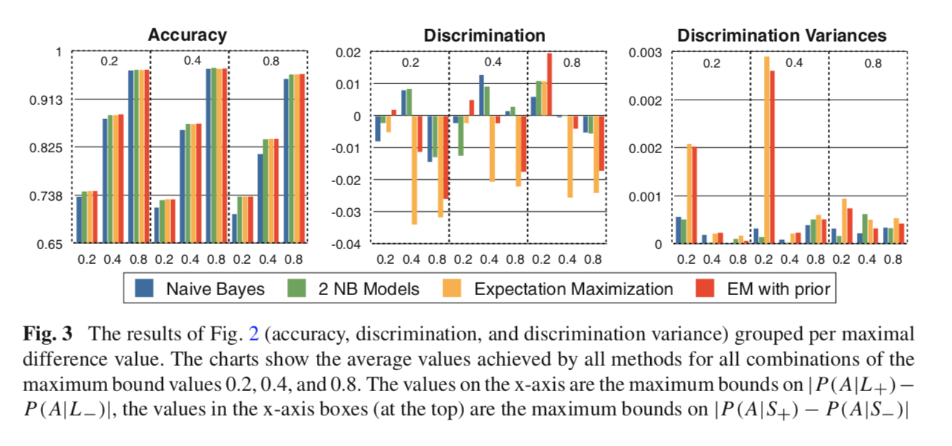
Resultados

Slide 19
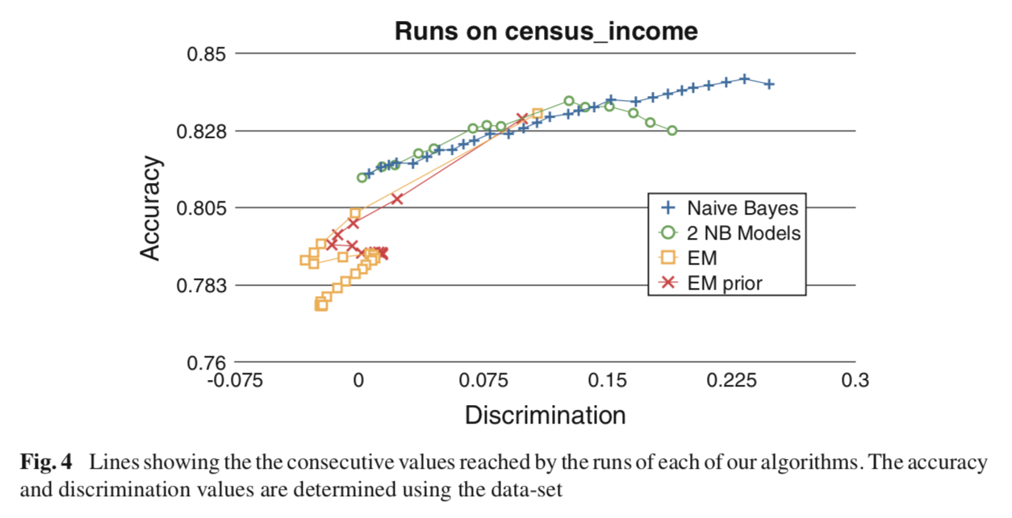
Resultados

Slide 20


Discrimination-aware tree construction
Notes:
The optimization criteria used are usually locally optimizing the overall accuracy of the tree, e.g., based on the so-called information gain. Suppose that a certain split divides the data 𝐷 into 𝐷1, . . . , 𝐷𝑘.
where 𝐻Class denotes the entropy w.r.t. the class label, and 𝐷𝑖, 𝑖 = 1...𝑘 are the partitions induced by the splitting criterion under evaluation. From all splitting criteria being considered, the one that (locally) optimizes the information gain is chosen.

Slide 21
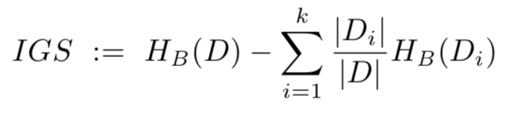
Discrimination-aware tree construction
Notes:
When evaluating the splitting criterion for a tree node, not only its contribution to the accuracy, but also the level of discrimination caused by this split is evaluated.
under evaluation on the discrimination of the resulting tree. To measure the influence of the introduction of a split on the discrimination, we will use the same notion of information gain, but now also w.r.t. the sensitive attribute 𝐵 instead of only w.r.t. the class Class. This gain in sensitivity to 𝐵 will be denoted IGS;

Slide 22
Discrimination-aware tree construction
IGC - IGS
IGC / IGS
IGC + IGS
Notes:
IGC-IGS: We only allow for a split if it is non- discriminatory, i.e., we select an attribute which is homoge- nous w.r.t. class attribute but heterogenous w.r.t. sensitive
IGC/IGS: We make a trade-off between accuracy and discrimination by dividing the gain in accuracy by gain in discrimination.
IGC+IGS: We add up the accuracy gain and the discrim- ination gain. This favors splits that result in a homogenous tree w.r.t. both accuracy and the sensitive attribute. Even though this measure in isolation does not make sense as it favors more discrimination, it will lead to good results in combination with the relabeling technique we show next.

Slide 23
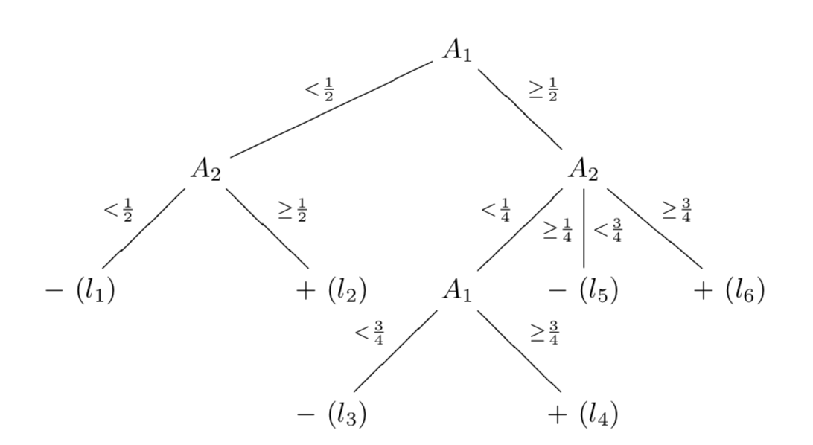
Leaf relabeling
Trocar o label (classe) de um conjunto de folhas visando diminuir a discriminação com menor perda de acurácia

Slide 24
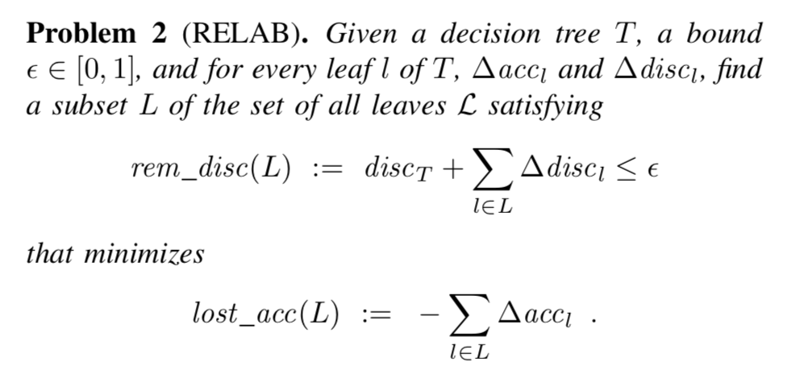
Leaf relabeling

Slide 25
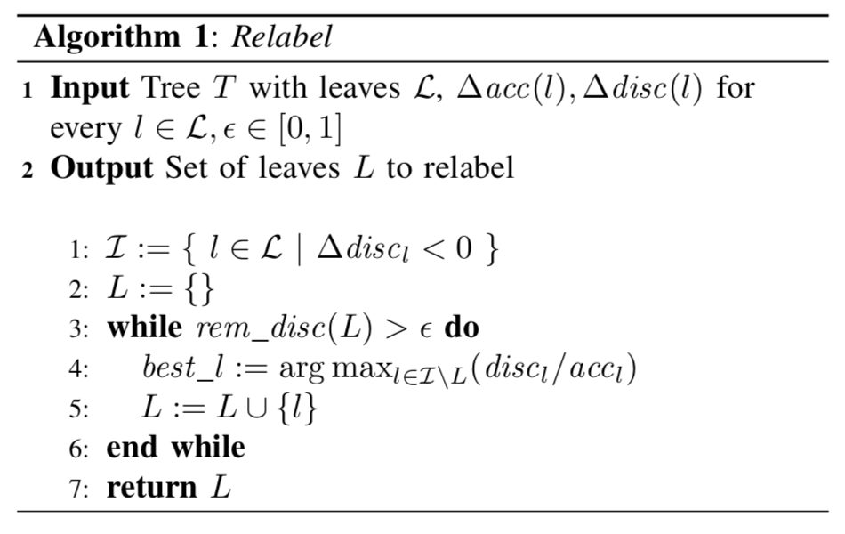
Leaf relabeling
Notes:
Based on the connection with the KNAPSACK problem, the greedy Algorithm 1 is proposed for approximating the most optimal relabeling.

Slide 26
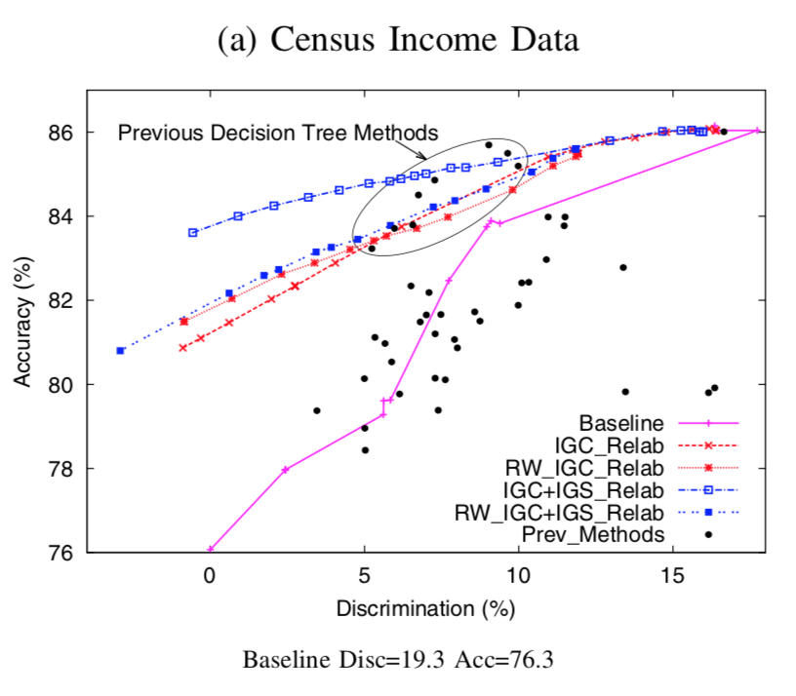
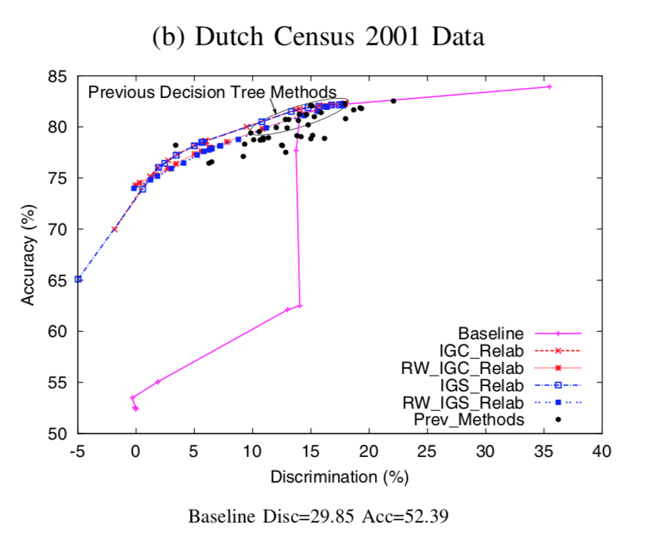
Resultados
Notes:
The compar- isons show clearly that relabeling succeeds in lowering the discrimination much further than the baseline and previous state-of-the-art approaches.
We observe that the discrimination goes down by removing the sensitive attribute and its correlated attribute but its impact on the accuracy is very severe. On the other hand the discrimination aware methods classify the unseen data objects with minimum discrimination and high accuracy for all values of 𝜖. Figure 2 shows that our proposed methods outperform the current state-of-the-art methods w.r.t. both accuracy and discrimina- tion.
Ideally we would have non- discriminatory test data at our disposition. If our test set would be non-discriminatory, we expect our discrimination aware methods to outperform the traditional method w.r.t. both accuracy and discrimination.
In Dutch 1971 Census data, there is more discrimination toward female and their percentage of unemployment is higher than in the Dutch 2001 Census data. Now if we learn a traditional classifier over 1971 data and test it over the same dataset using 10-fold cross validation method, it will give excellent performance as shown in Figure 3 (a). When we apply this classifier to 2001 data without taking the discrimination aspect into account, it performs very poorly and accuracy level goes down from 89.6% (when tested on 71 data; Figure 3 (a)) to 73.09% (when tested on 2001 data;

Slide 27
Referências
Discrimination Aware Decision Tree Learning.
Faisal Kamiran, Toon Calders, and Mykola Pechenizkiy. In Proceedings of the 2010 IEEE International Conference on Data Mining (ICDM '10). IEEE Computer Society, Washington, DC, USA, 869-874.
http://dx.doi.org/10.1109/ICDM.2010.50
Three naive Bayes approaches for discrimination-free classification.
Toon Calders, Sicco Verwer. Data Min Knowl Disc (2010) 21: 277.
https://doi.org/10.1007/s10618-010-0190-x

Slide 28
Reduzindo discriminação em classificadores
Hilton Pintor (hpbl)
Victor Miranda (vmm)
github.com/if1015-datascience-ufpe/2018-2-ex3-p2p

